Slide 1
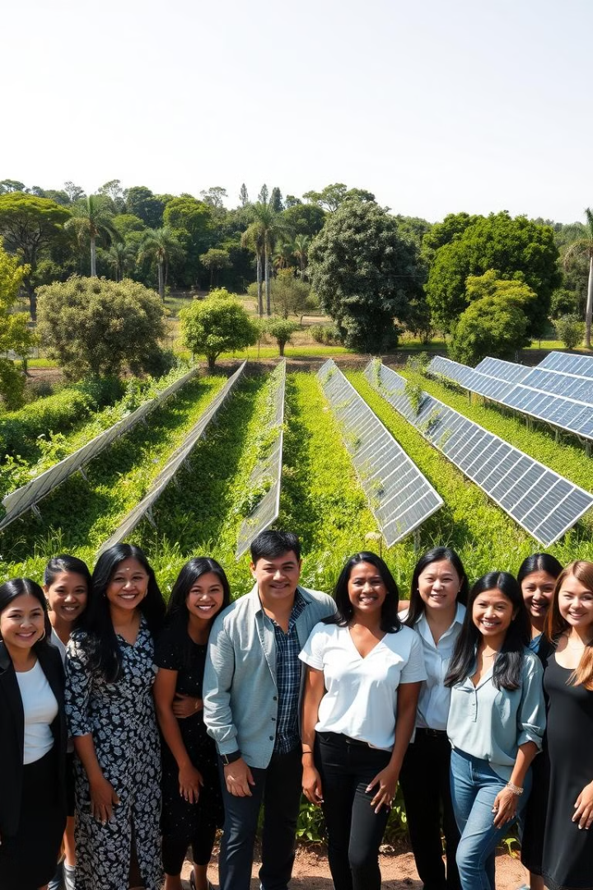
Wasruk(PCS 25-36)
Bringing Wellness to Life
This project aims to reduce the amount of waste that ends up in landfills by implementing innovative waste management strategies. Through collection, sorting, recycling, and disposal services, the project seeks to support residential areas, commercial establishments, and industrial facilities in managing waste sustainably. By offering tailored waste management solutions, it strives to build a more sustainable future and transform the waste management industry.

Slide 2
Project Abstract
Overview
Key Objectives
Approach
WASRUK is a technology-driven waste management solution that incentivizes households to segregate waste, promoting recycling and sustainability. By rewarding users for their contributions, it fosters active participation in environmental initiatives, reduces landfill burden, and integrates with recycling facilities to create a circular economy.
Reduce landfill waste, engage the community in segregation, transform waste into valuable products, promote self-sufficiency, and use technology to streamline and incentivize waste management.
WasRuk collects segregated waste, rewards participation, and processes it for recycling or biogas. Technology manages the system, and partnerships enhance the impact.

Slide 3

Project Goals and Objectives
Minimize Landfill Waste
1
Reduce the volume of waste sent to landfills by promoting efficient waste segregation and recycling practices at the source.
2
Promote Community Engagement
Educate and incentivize households to actively participate in waste segregation, fostering a culture of sustainability.
Support a Circular Economy
3
Transform collected waste into reusable resources, generating revenue through recycling and biogas production while reducing reliance on imported waste.

Slide 4
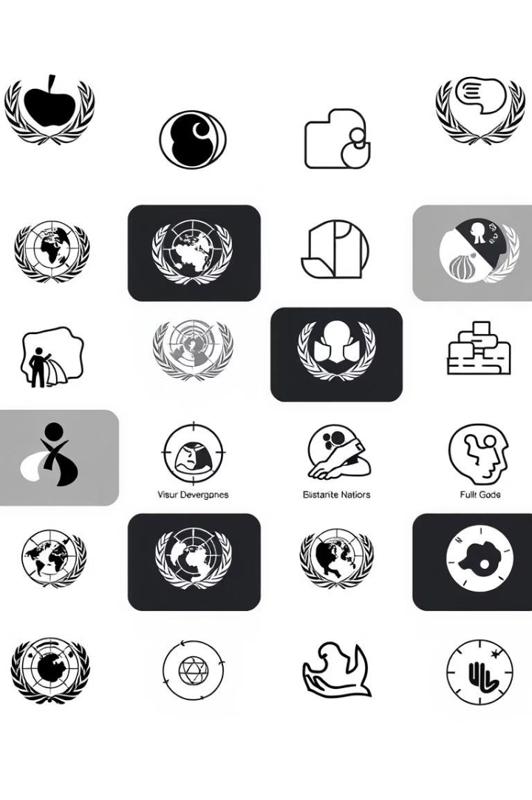
Alignment with UN Sustainable Development Goals (SDGs)
SDG 11: Sustainable cities and Communities
SDG 13: Climate Action
Supports responsible consumption by encouraging recycling and a circular economy.
Promotes cleaner cities by reducing waste and landfill use.
SDG 12: Responsible
Consumption and
Production
SDG 17: Partnerships for the Goals
Strengthen global partnerships between industries, governments, and communities for better waste management.
Mitigates climate impact by reducing landfill emissions and fostering sustainable community practices.

Slide 5





Methodology and Approach
Circular Economy
Promotes recycling and waste reduction by creating systems that reuse materials, supporting sustainable production and consumption.
Community Engagement and Awareness
Educates and involves communities in responsible waste practices to foster environmental stewardship and collective climate action.
Technological Innovation in Waste Processing
Adopts advanced technologies for efficient waste sorting, recycling, and waste-to-energy solutions, reducing landfill impact.
Public-Private Partnerships for Sustainable Waste Management
Strengthens collaborations between governments, businesses, and NGOs to enhance waste management infrastructure and sustainability efforts.

Slide 6




Expected Outcomes and Impact
Waste Reduction
Economic Impact
Community Empowerment
Decrease landfill waste significantly by increasing recycling rates.
Generate revenue through the sale of segregated waste materials.
Establish a reward system that encourages public involvement in waste management.

Slide 7

Key Project Deliverables
Online Platform and App
Facilitate waste tracking and reward redemption.
Partnerships
Collaborate with recycling industries and local government for support.
Waste Collection Infrastructure
Develop an efficient waste collection and processing system.

Slide 8

Next Steps and Conclusion
1
Expand Operations.
2
Build Partnerships.
Scale the WasRuk model to other cities and regions.
Build relationships with local authorities and waste processing industries.
3
Monitor Impact.
Regularly assess project progress to improve efficiency and effectiveness.

